Slide 1
Shaping the Narrative: Heathens in the Media
Lauren Crow-Thacker
July 28, 2017
Notes:
This template is in wide-screen format and demonstrates how transitions, animations, and multimedia choreography can be used to enrich a presentation.

Slide 2
Shaping the Narriative
Speaking with the Media
Building Reputations
How the Media Sees Us
Overview

Slide 3
Shaping the Narriative
Speaking with the Media
Building Reputations
How the Media Sees Us

Slide 4
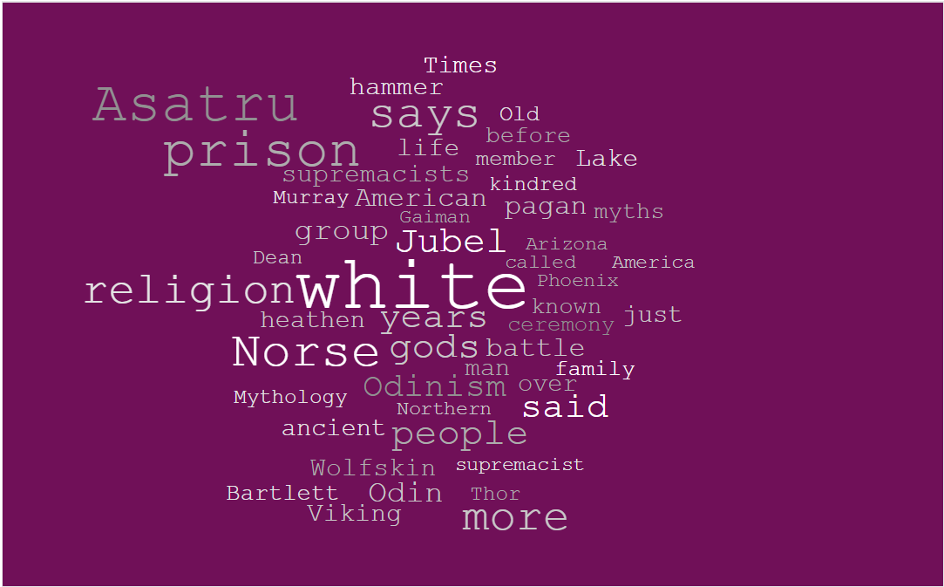
How Does the Media See Heathenry?
Survey of Google News July 18, 2017

Slide 5
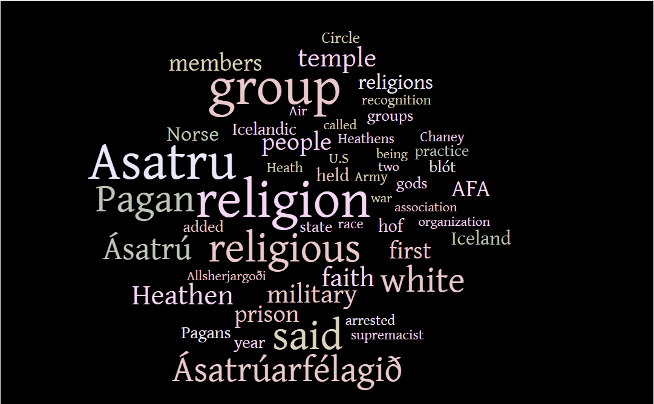
How Does the Media See Asatru?
Survey of Google News July 18, 2017

Slide 6
Headlines
Survey of Google News July 18, 2017

Slide 7
Shaping the Narriative
Speaking with the Media
Building Reputations
How the Media Sees Us
Overview

Slide 8
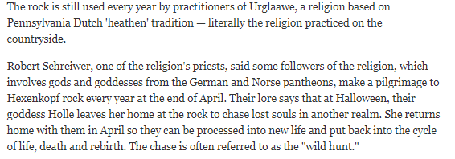
Case Study: Distelfink Sippschaft
The Morning Call October 31, 2016

Slide 9
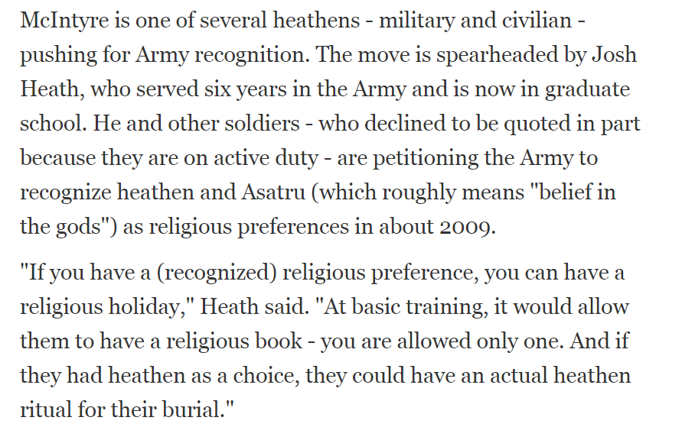
Case Study: Open Halls Project
The Gazette. July 12, 2015

Slide 10
Case Study: Open Halls Project
Created “Heathen Resource Guide for Chaplains
Petitioned repeatedly to have Asatru/Heathenry recognized by US Militatry
The Gazette. July 12, 2015

Slide 11
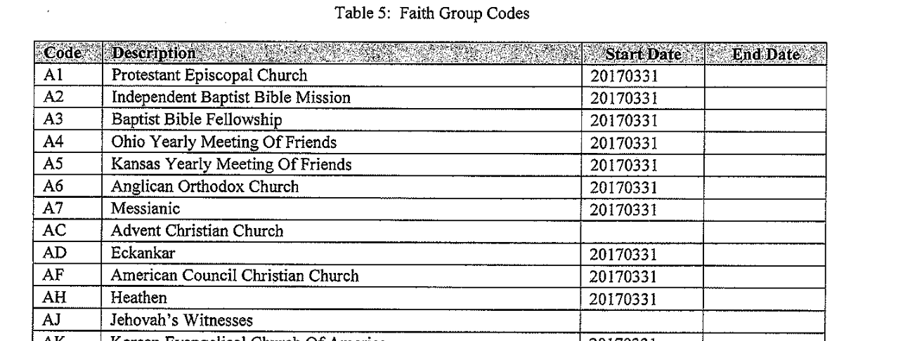
Case Study: Open Halls Project
Office of the Assistant Secretary of Defense

Slide 12
Shaping the Narriative
Speaking with the Media
Building Reputations
How the Media Sees Us
Overview

Slide 13
How to Talk to the Media
Who
Organizers and leaders of events and groups
Someone the average person will relate to
Someone who can speak authoritatively on the topic
Put your best face forward

Slide 14
How to Talk to the Media
When
When hosting a public event
When the local media has been critical of Heathens
Holidays

Slide 15
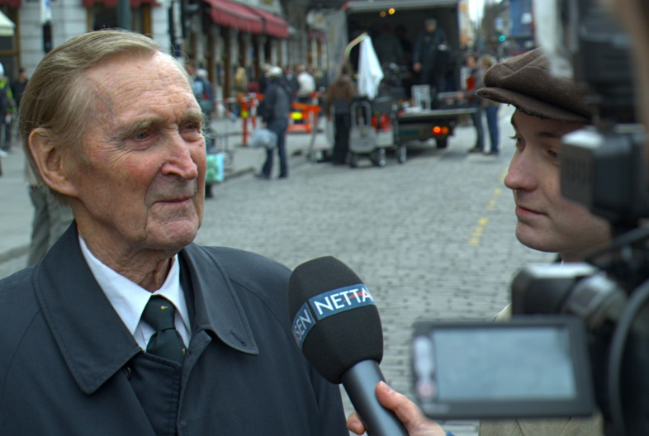
How to Talk to the Media
Remember Diversity
Identify Yourself
Brevity and Soundbytes
Plain Language
Focus on your main points

Slide 16
How to Talk to the Media
Press Kit
Information on your group
Fact Sheet on the issue
Statements of support
Press release

Slide 17
Collectively, we must do more than simply watch, with resignation and a feeling of powerlessness, reports on the evening news about the latest terrorist atrocity.
Michael Jeffery

